Slide 1
Countdown for Android
Multiplayer game for Android OS

Slide 2
About us
Supervisor: Darragh O’Brien
Developers: Gheorghe-Vasile Burac & Bartlomiej Kiraga

Slide 3

The Game (not the artist)
There rounds:
Letters
Numbers
Conundrum

Slide 4
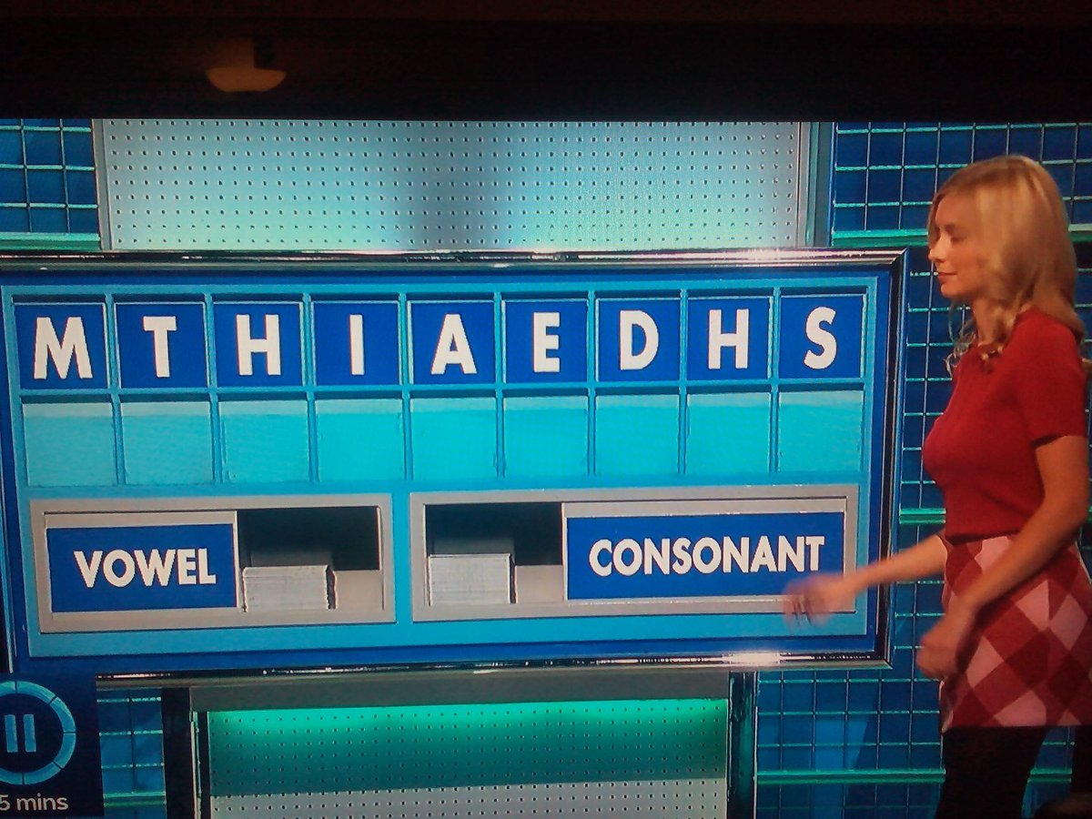
Letters
select between vowels and/or consonants nine times
create longest possible word

Slide 5
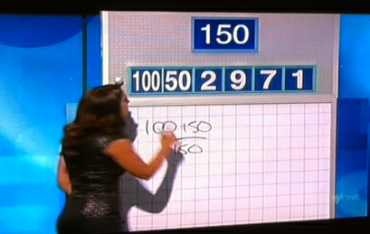
Numbers
user receiving a random number and a set of six numbers
must obtain a number close or equal to the target number

Slide 6
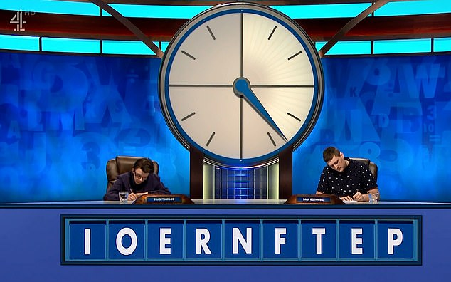
Conundrum
User must create a word using all nine letters given

Slide 7
Scoring
Letters: length of the word produced in Letters round
Numbers: target number or proximity to it
Conundrum: find the nine letters word
The winner: a person named Victor

Slide 8


Technologies & Tools
Java and Kotlin
Android Studio
Kotlin-friendly SDK
Nginx

Slide 9
Division of work
Pair programming
Architecture of the app
Game server
Letters, Numbers & Conundrum
UI
Code Reviews
Testing

Slide 10
Learning challenges
Kotlin
Android app development
Java libraries
Professional UI
Trie & other data structures
Algorithms
Zip file processing

Slide 11
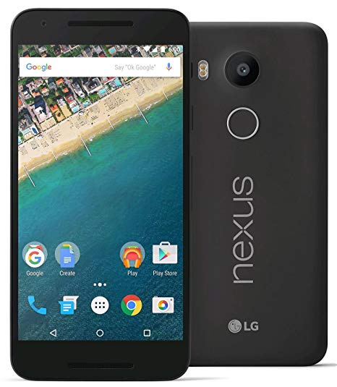
Hardware & Software
Mobile devices
Android

Slide 12
Special requirements
None

Slide 13
Q&A

Slide 14
Thank you

